Slide 1
Healthy Lifestyle Initiative
Jo Britt-Rankin & Mary Leuci
University of Missouri

Slide 2
Healthy Lifestyle Initiative
The Healthy Lifestyle Initiative brings community stakeholders together to create community-driven plans of action focused on environmental and policy changes to create communities that support:
The availability of healthy, locally-produced food
Opportunities for safe, accessible physical activity

Slide 3
Mission
Making the healthy choice
the easy choice.

Slide 4
What is HLI?
In 2007, MU Extension commissioned a study of their plan-of-work to determined what interdisciplinary theme would be best to focus on for the coming years.
The goal was to find one theme for which all parts of the organization as well as the campus could impact
The independent reviewer selected Health

Slide 5
The HLI Model
Previous multidisciplinary program
Extension Community Economic and Entrepreneurial Development program (ExCEED)
Uses an engagement and collaborative learning model to re-energize local communities and regions to build and further develop sustainable economies based on strengths and assets identified locally.
Notes:
ExCEED was the first all-organization effort that MU Extension had undertaken
HLI was to be the second
(I’m sure you can explain ExCEED and it’s successes better than I!)

Slide 6
The HLI Model
Model Multidisciplinary Team Approach
Commercial Agriculture Program
Multidisciplinary teams make farm/community visits to address program needs and address problems through a team approach
Notes:
While ExCEED has been successful, it relied on a team of county-based Extension faculty to engage the community and had limited campus-based faculty
Given the declining numbers of county-based Extension faculty and a desire to engage resident teaching and research faculty, it was determined that we needed more campus-based resources. We studied the Commercial Ag Program which had utilized a campus-based team approach.
The Commercial Agriculture Program was developed in the mid-80’s
This program has seen much success in using multidisciplinary teams
Make visits to farms/communities to address problems or program needs
Visits were always made as a team so that each discipline can bring their perspective to addressing the issue
The campus team always engages the local county-based Extension faculty
For HLI, we determined that we would develop a campus-based team that would travel to HLI communities
Initially the campus team met with each of the four initial communities on a monthly basis
Even though it is not feasible to meet with over 20 communities each month, one member of the campus team is the point person for each community.
The campus lead meets with the community team then engages the whole campus team as well as seeking resident faculty expertise, as needed
Each team member is also responsible to meet with and update their respective Extension Program Director regularly

Slide 7
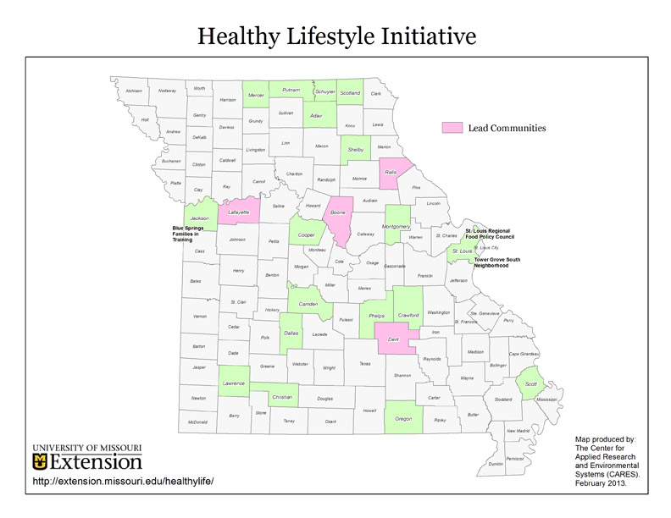
Notes:
Each of you has this map as a handout.
The 4 communities in pink were the initial communities
Over time we have added the next 19 communities
These communities did not receive the same financial support
$5,000 each
9 of 19 were added in the second year of HLI. They went through the same application process
the final 10 communities have been added, but all have sought out HLI for assistance
Not highlighted on this map but Vernon County with the Healthy Nevada project will be added in FY14
Nevada is in the Southwest Region of the state
Healthy Nevada is a partnership between Cerner Corporation, Cottey Hospital and the Nevada community
They sought out HLI and MU Extension to assist them in meeting their goals over the next four years
Healthy Nevada is a 5-year, $5M project with goals similar to HLI

Slide 8
Initiative Structure
Then . . .
Co-Directors
Assoc Ext Prof (Nutrition)
4 Extension Associates
Ag & Natural Resources
Business Development
Community Development
4-H/Youth Development
Administrative Asst
County Extension Faculty
Community Teams
Now . . .
Director
Assoc Ext Prof (Nutrition)
4 Subject Matter Leads
Ag & Nat Res (Grad St)
Bus Dev (Ext Assoc)
Comm Dev (Grad St)
4-H/Youth Dev (VISTA)
Administrative Asst
County Extension Faculty
Community Teams
Notes:
Ann Cohen, Associate Extension Professor, in the Department of Nutrition & Exercise Physiology has lead the program since its inception.
For the first 4 years, she co-lead the program with Dale Brigham, also Assoc Ext Professor, in Nutr & Exercise Phys
Dr. Brigham took a teaching position and left the HLI program. His position was not replaced
Initially, 4 Extension Associates were hired to represent 4 of the 5 areas of MU Extension. Ms. Cohen represented HES to save the cost of hiring a 5th Extension Associate
About 2 years into the project, 3 of the 4 Associates had moved on to new positions (all promotions).
It was determined that the team could be rebuilt using graduate students or VISTA workers
This method would still allow us to have one person from each Extension area
Hiring grad students or VISTA workers is more financial reasonable
Hiring grad students or VISTA workers also provides opportunities to potentially new Extension faculty
Before a community was accepted into the initiative, they had to provide documentation/evidence of an actively engaged task force focused on community health
Each community task force also need to have, at least, one Extension faculty member engaged in their efforts.
This faculty member served as the point-of-contact for the campus team
Additional regional faculty were engaged based upon the needs/projects of the community

Slide 9
Focus
Policy
Policies can be informal, such as rules that encourage healthy snacks at school or workplace gatherings, or formal, such as a local ordinance that prohibits smoking in bars, restaurants and public buildings.
Notes:
Extension has a rich history of providing research-based programs
Yet, educational programming alone has not enabled us to combat the overweight, obesity and the nutrition-related diseases
Following the model of the Robert Wood Johnson Foundation, HLI decided to use a community development-based model to focus on policy and environmental change
Although a more long-term approach, it is more sustainable and enables communities to meet their overall goals of reduced nutrition-related disease states

Slide 10
Healthy Lifestyle Initiative
Goal : Increase Community Access to Affordable Locally-Produced Healthy Food
Increase healthy food availability/awareness in schools
Increase community awareness of healthy food options
Increase access to locally grown healthy food

Slide 11
Focus
Environment
The environment refers to our surroundings, including the built environment of streets and sidewalks, buildings and parks, workplace and school environments and social environments –the social networks and norms that influence our behavior.

Slide 12
Healthy Lifestyle Initiative
Goal : Increase Opportunities for Safe, Accessible Physical Activity
Increase the miles of developed trails
Increase community access to existing facilities
Increase participation in phys activity programs
Worksites develop or expand staff wellness programs

Slide 13
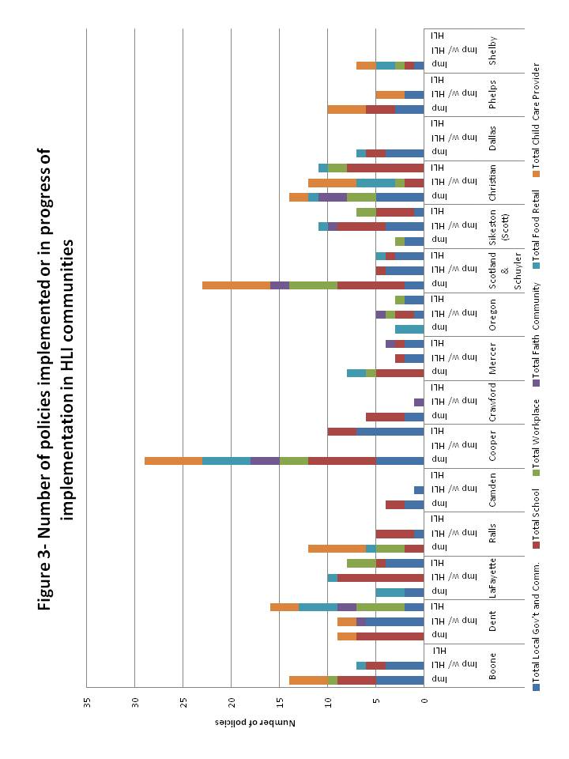
Notes:
Each of you have this graph on the back of the statewide map
This graph shows the number of policies implemented or in progress of being implemented within the HLI communities
The colors denote policies by segment of the community
Local Government & Community
Schools
Workplace
Faith-based Community
Food Retailers
Child Care Providers

Slide 14
Program Products
WorkWell Missouri Tool Kit
High Tunnel Manual & Curriculum
Seasonal & Simple
Photovoice Missouri
Notes:
HLI has been very successful in producing materials that are being accessed widely by communities
To date, almost $100,000 in publications have been sold in the first 6 years of the Initiative
In the next few slides I will describe a few of the most successful products developed by the HLI team

Slide 15
WorkWell Missouri Tool Kit
Developed to assist businesses in starting, expanding or maintaining a staff wellness program
Focus is on reducing the risk factors for chronic diseases such as poor nutrition, inactivity, stress and tobacco use.
Notes:
WorkWell is for businesses who want to begin, expand or maintain a staff wellness program
In developing this manual, HLI team members engaged the City of Sikeston staff to assist in the process

Slide 16
WorkWell Missouri Tool Kit
Step-by-step guide for employers
To assess their worksite
Identify what types of programs to implement
Implement wellness programs
Determine effectiveness
Notes:
This manual not only demonstrates each step of the process
This manual can be used by businesses who have no budget to those who have substantial resources to devote to a wellness program
This manual can help employers reduce lost productivity due to health related diseases and sickness
Given the increasing health/insurance costs facing businesses, this resource can assist them in reducing these expenses

Slide 17
High Tunnel Manual/Curriculum
Curriculum was designed for use in Missouri agriculture education classrooms.
Ten lessons/units
Intended for upper classmen (junior/senior)
Each lesson contains a detailed lesson plan, PowerPoint and handouts.
Available free on HLI website
http://extension.missouri.edu/healthylife/resources/hightunnel.htm
Notes:
Curriculum was modified for Missouri vocational agriculture classrooms.
Originally authored by Iowa State University faculty
Project lead by two Ag Ed doctoral students
Initial training for vocational ag teachers in January 2013
48 teachers were trained
List of 10 lessons:
Lesson 1: Introduction to High Tunnels Lesson 2: High Tunnel Site Selection Lesson 3: Selection and Construction Lesson 4: High Tunnel Maintenance Lesson 5: Soil Management and Fertility Lesson 6: Mulches and Drip Irrigation for High Tunnels Lesson 7: Bed Arrangement and Plant Spacing Lesson 8: Produce Suited to High Tunnels Lesson 9: Integrated Pest Management Lesson 10: High Tunnel Business Planning and Marketing

Slide 18
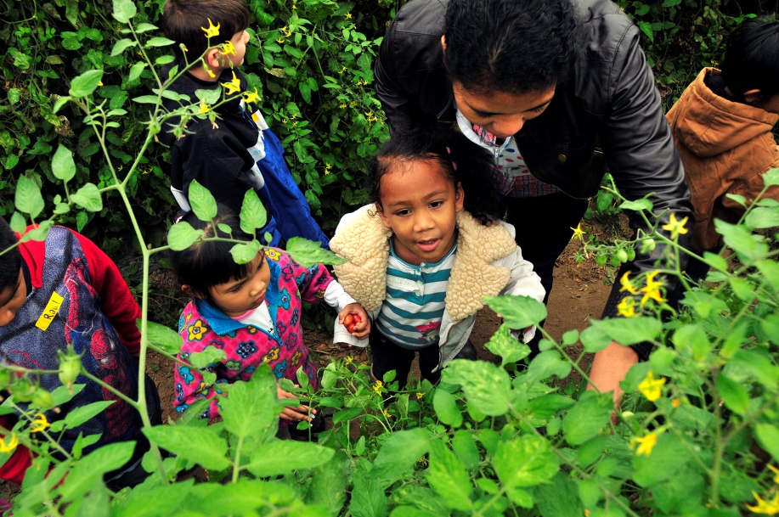
Notes:
These are two pictures are from the local farmer’s markets and demonstrate a few of the HLI communities ability to increase access to healthy, affordable, locally-grown foods

Slide 19
Seasonal & Simple
Seasonal & Simple
Seasonal & Simple app
Recipe demonstration videos
Seasonal & Simple for Food Service
Grow. Eat. Grow
http://seasonalandsimple.info/
Notes:
The Seasonal & Simple book was developed to enable consumer to select fresh produce in season
the full-color book includes selection, preparation and storage information
Each fruit or vegetable also has one or more recipes to illustrate how to incorporate the item into your diet
Based upon the successful nature of the Seasonal & Simple book, faculty engaged the app development class (Computer Sciences & Journalism)
To create an electronic version of the book
Students created the app, but also included farmers market and u-pick locations in Missouri
Users can select by region of the state
Knowing that not everyone is a smart phone user and knowing that many people like additional food preparation instruction, the HLI team engaged Chef Brook Harlan to record videos preparing the Seasonal & Simple recipes
Recipes can be found at http://extension.missouri.edu/healthylife/demovideos.htm
Given the increase efforts in the area of Farm-to-Institution, it was determined that a similar resource was needed by school food service directors
Funds were secured to provide trainings across the state to distribute the information during food service director trainings
The final piece of the suite of products is entitled Grow. Eat. Grow.
Grow. Eat. Grow is the Seasonal & Simple version for children.
The recipes included in this guide are kid-friendly and have simplified preparation

Slide 20
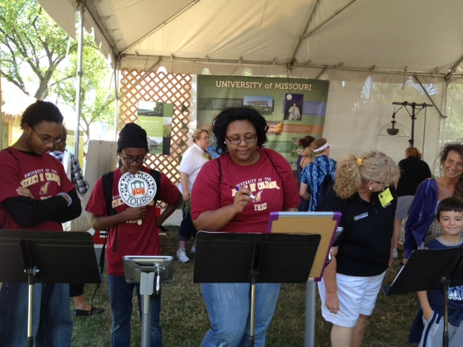
Notes:
The Seasonal and Simple app debuted at the 2012 Smithsonian Folklife Festival in Washington DC
More than 1,000,000 people attended the Festival
Those who came through the University of Missouri exhibit used the kiosks shown in the photo to use the app
The hard copy materials were also sold in the Festival Marketplace
Finally, throughout the two weeks of the Festival, several recipes included in the book were demonstrated in the Main Stage Kitchen
The app is available on the web, at the Apple Store as well as the Android Store

Slide 21
Engaging the Communities
Notes:
Developed a partnership that includes a broad representation of community organizations;
Created and distributes a monthly e-newsletter that serves as a primary communication tool;
Completed a survey of adult and youth attitudes toward healthy eating and physical activity;
Co-hosted food demonstration events, farmers’ market events, food preservation work-shops, and will host a food policy workshop;
Supported garden infrastructure improvements at a school learning garden;
Supported a statewide training on starting and sustaining community gardens
Started Master Gardener classes;

Slide 22
Developing Your Community Initiative
Step 1: Enlist and convene leaders and members of the community to begin talking, sharing and building a partnership.
Step 2: Assess the resources, needs and desires of the community.
Step 3: Educate yourselves and learn from others.
Notes:
Developing a community-wide health initiative will vary from community to community.
On our website, you can expand each of the five steps for information, expectations and resources for the initiative-development process.
Step 1
You will begin asking: Why do we want to create this community-wide health initiative? Who needs to be a part of this? Who will serve as the catalyst and facilitator? What do we want to do? How do we go about doing it?
Later, develop Purpose, Values and Vision statements along with an organizational structure that suits your particular needs.
Step 2
Assess the resources, needs and desires of the community.
Hold listening sessions, conduct surveys and interviews, gather data from government websites, and use other means to collect useful information about your community.
Also, take time to understand both the real and perceived challenges and opportunities.
Step 3
Educate yourselves and learn from others.
Invite guest speakers from inside and outside the community to share their expertise, search the web for information about similar initiatives in other states, and compile examples of policies and environmental change strategies that have been successful in other places.

Slide 23
Developing Your Community Initiative
Step 4: Develop an action plan with attainable, measurable goals that helps change policies and environments in your community.
Step 5: Seek resources for implementing the action plan.
Notes:
Step 4
Develop an action plan with attainable, measurable goals that help change policies and environments in your community.
Include plans for creating new programs or enhancing existing programs if they can
1) ultimately lead to policy and environmental changes,
2) serve as a model which can be replicated elsewhere, or
3) become sustainable and self-supporting over time.
The action plan will be a reflection of the information learned, gathered, generated and shared in steps 1-3.
Step 5
Seek resources for implementing the action plan.
Identify the parts of the plan that don’t require additional resources.

Slide 24
Evaluation
Photovoice has been around for almost 20 years.
Gives people a chance to represent their community or point of view in photographs, video or slideshows.
A narrative is created along with the visual presentation.
Is intended to create dialogue
Notes:
Although we have used a number of methods to evaluate the success of HLI, one that we are most proud of is Photovoice
Although the process has been used for almost 20 years, it has been rarely used within Extension
Photovoice engages community members (we used junior high and high school students) in a dialogue through the use of photographs and written narrative that accompanies each photo

Slide 25
Photovoice
Photography + Social Action
= Change

Slide 26
PhotoVoice Missouri
A statewide health photography program and competition
Collaboration between Health Communication Research Center (School of Journalism) and Healthy Lifestyle Initiative (MU Extension)
Students were to show, through pictures, examples in their communities that support healthy choices, and areas that need improvement.
Notes:
Our Photovoice project was entitled Photovoice Missouri
We worked with the Health Communication Research Center which is located in MU’s School of Journalism
Jon Stemmle, Director
Our evaluation project used junior high and high school students who took photographs then wrote about the examples within their communities that supported healthy choices and what areas needed improvement
Winners of the photography contest were announced during the annual community summit

Slide 27
Photovoice Missouri
“Our goal going in was to introduce the students to a way to get their thoughts and concerns about the health of their communities heard. Based on what we’ve seen, I believe that’s happened and it’s created a dialogue that we hope will continue.”
--Jon Stemmle, Director HCRC
Notes:
To date, Photovoice has only been used with HLI as a means of program evaluation.
In February 2014, Jon and the staff at the Health Communication Research Center will provide training for MU Extension faculty so that this methodology can be used as a means of program evaluation
For more information on Photovoice, contact HCRC

Slide 28
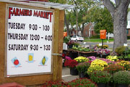
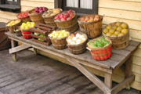
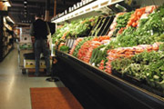
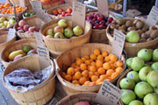
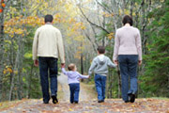
Notes:
The Healthy Lifestyle Initiative has provided new opportunities for over 20 communities to date:
A few of the accomplishments by just the INITIAL 4 COMMUNITIES
Supported the development of a farmers’ market blog that highlights local vendors;
Obtained a grant from the USDA to expand the infrastructure of a farmers’ market;
Obtained a grant to purchase supplies for community gardens
Supported the increase in offerings of locally grown and healthy food in three of the county’s school districts
Supported the develop of school gardens and after school gardening programs at two elementary schools
Established a second farmers’ market in the county and with grant money, sponsored several events to promote the markets
Worked with Missouri Department of Transportation to build one mile of new sidewalk in downtown
Implemented the Active and Healthy Schools program in one elementary school to increase physical activity during and after school
Used the Smoothie Cycle to promote healthy eating and physical activity to hundreds of people at school and community health fairs
Held cooking classes and cooking demonstrations using healthy and seasonal food at schools
Received a GPS/GIS grant for mapping programs that will be used by 4-H kids to develop and map walking/biking trails in the community
Over $300,000 in tax credits were awarded in one community

Slide 29
Next Steps
To assist communities in sustaining their efforts
To assist communities in leveraging additional dollars
To sustain the program through external funding
Notes:
FY14 is the final year of support for this effort through MU Extension cost dollars
Program Sustainability is the main focus of this year
Securing on-going external funding
Assisting communities in sustaining their efforts
Assisting communities to secure on-going financial resources

Slide 30
Thank You
Questions?
http://extension.missouri.edu/healthylife/

